Slide 1
Scalable Logo Recognition using Proxies
Istvan Fehervari
Srikar Appalaraju
Machine Learning Scientist istvanfe@amazon.com
Sr. Machine Learning Scientist srikara@amazon.com

Slide 2
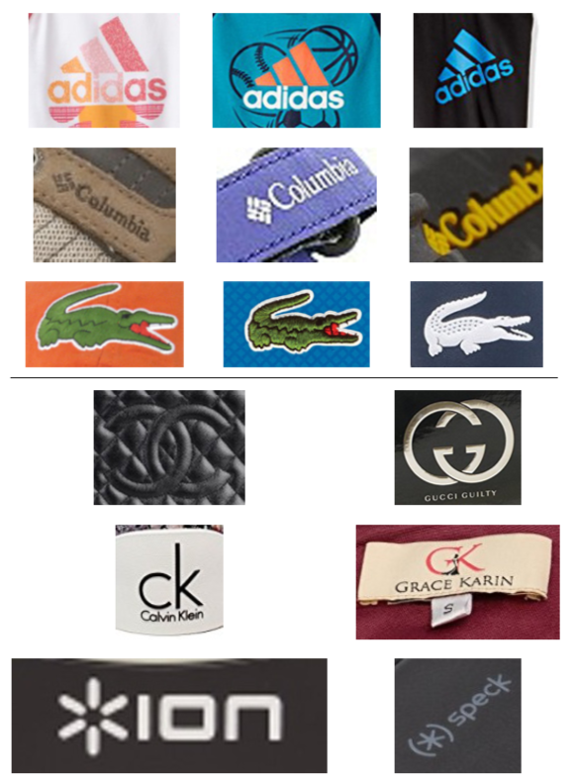
Logo detection is hard
What is a logo?
High inter- and intra-class variations
Can appear in any context
Data collection is problematic
Re-training for every new logo is impractical

Slide 3
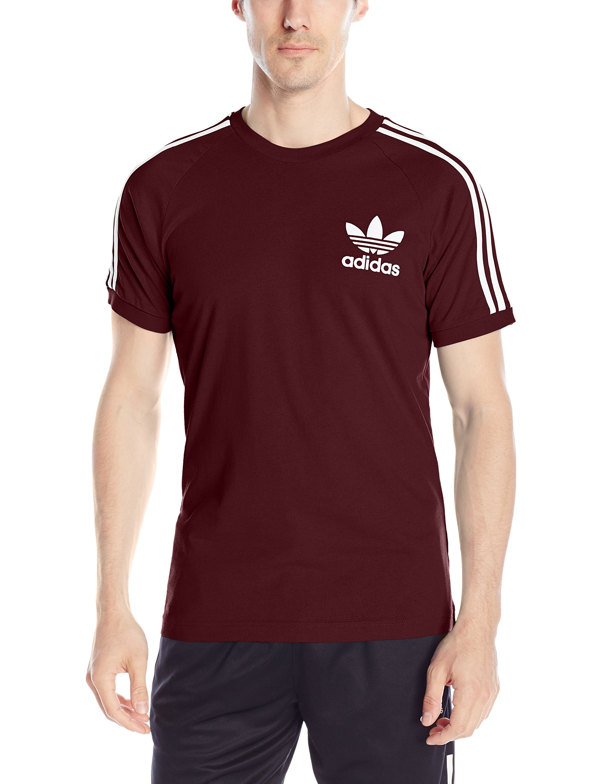
Class-agnostic detector + similarity search
Decoupling detection and recognition
Adidas
(0.98)

Slide 4
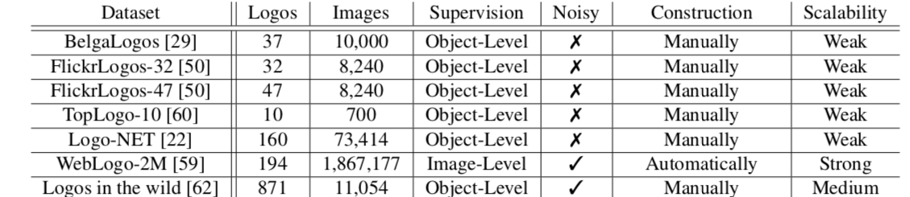
Current public datasets are too small
Not enough logo classes or missing bounding-box level annotation to train a good object detector

Slide 5
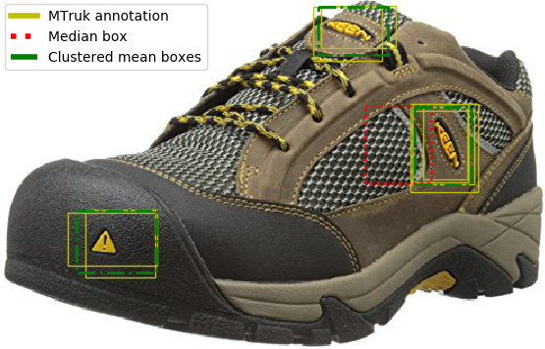
New dataset: PL2K
Amazon Catalog images from the top 2K brands
Large body of weakly-labeled images available
Popular brands with lot of logo impressions were prioritized
Logos must be present on products for brands to be considered
Sampled 1M images, annotated with Amazon Mechanical Turk
Task was formulated as binary object detection

Slide 6
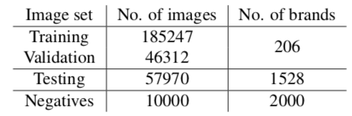
New dataset: PL2K
Data for class-agnostic detector:
Annotations were cleaned up with dbscan using IoU > 0.6
Data for few-shot logo detector:
Top 242 logos extracted with the detector
700 different cropped region for each logo

Slide 7
Universal logo detector
Binary object detection: Logo or not logo
Tested the following architectures:
Faster R-CNN
Single Shot Multibox Detector (SSD)
YOLOv3
Models were evaluated on PL2K and FlickrLogos-32 (without retraining)

Slide 8
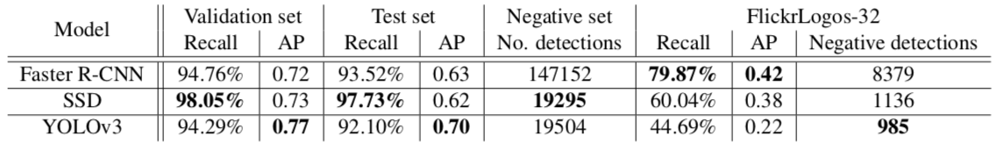
Universal logo detector: results
Faster R-CNN produces an order of magnitude more FP
YOLOv3 performs the best on PL2K, but the worst on FlickrLogos-32
SSD has the highest recall

Slide 9

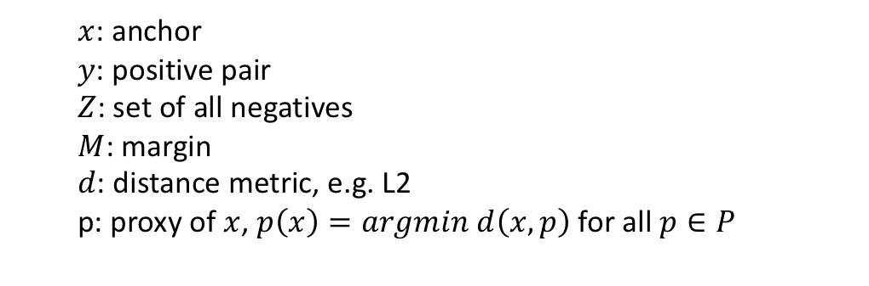
Few-shot logo identification
Distance metric learning using proxy embeddings
Reformulate triplet loss using small batches without sampling
Positive and negatives are replaced by proxies of the same class
Proxy embeddings are randomly initialized and learned during training
Modified SE-Resnet50 as feature extractor
$$L_{triplet}\left(x,y,Z\right)={\left[d\left(x,p\left(y\right)\right)+M−d(x,p\left(Z\right))\right]}_{+}$$
$x$: anchor
$y$: positive pair
$Z$: set of all negatives
$M$: margin
$d$: distance metric, e.g. L2
p: proxy of $x$, $p\left(x\right)=argmin d\left(x,p\right)$ for all $p∈P$

Slide 10
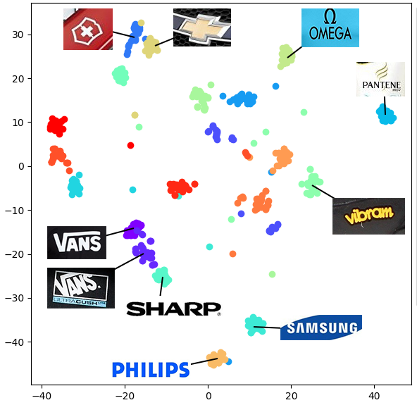
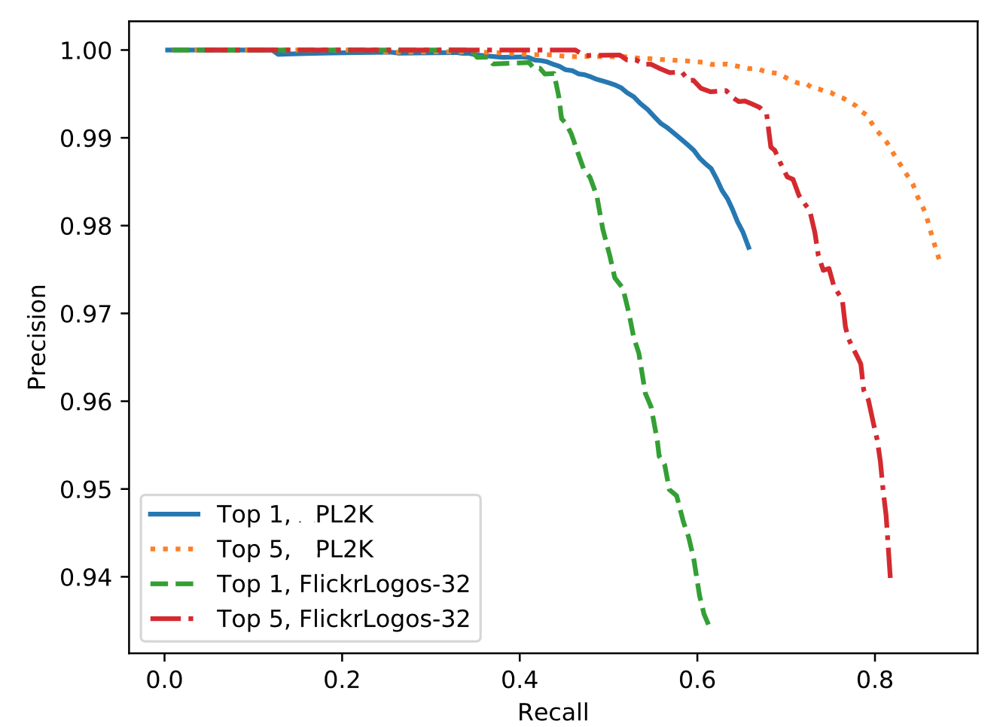
Few-shot logo identification: results
Proxy-triplet loss outperforms related approaches
State of the art results on FlickrLogos-32 on unseen logos

Slide 11
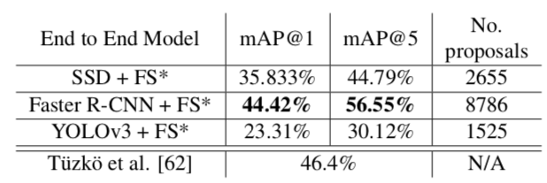
End-to-end evaluation
Faster R-CNN + SE-Resnet50 with spatial transformer
More proposals, STL helps in orienting text-heavy logos
Used the first 5 images per logo in our index for the kNN search
State of the art mAP among open-set detectors

